Slide 1
Local DNS Attack Lab
Kevin Du,
Chetan Jaiswal

Slide 2
Objectives
Understand what DNS is
Know the basic flow of the DNS query
Understand and practice the local DNS cache poisoning attack

Slide 3

Prepare for the lab
You will need 3 VMs.
NAT-Network
Local DNS server
User VM
Attacker VM

Slide 4
Agenda
1. Background
2. The flow of the translation from domain name to IP address
3. Local DNS attack using netwox

Slide 5


What does DNS do? Just like a phone book
What is the IP address of www.example.com?
www.example.com
93.184.216.349
www.truman.edu
150.243.160.85
…
…
Take a look here

Slide 6


General flow to get an IP
Do I know www.example.com’s IP address?
Do I know www.example.com’s IP address?
Global DNS
On the Internet
If no, ask the global DNS servers on the Internet for the answer
If no, ask the local DNS server

Slide 7
Local Network
Global DNS
User Computer 10.0.2.7
Local DNS server
(Bind9)
10.0.2.16
DNS Server
DNS Server
app
/etc/hosts
1
Internet
Network Settings:
Local DNS server
query
Bind9 Resolver
6
4
DNS Server
DNS Server
2
Answer
DNS record cache
5
7
3
Detailed flow to get an IP: Local DNS server uses Bind9; OS is Linux

Slide 8


Task: Bind9 Server Setup
Flush the server cache/data:
$ sudo rndc flush
Restart the server:
$ sudo service bind9 restart

Slide 9
Configure the DNS settings for the user VM
Usually, the user machine has got a default local DNS server; However, in this lab we want to have control on the local DNS server. We need to set the Network configuration.
My DNS server:
10.0.2.16
I know whom to ask
User machine
Local DNS server 10.0.2.16

Slide 10
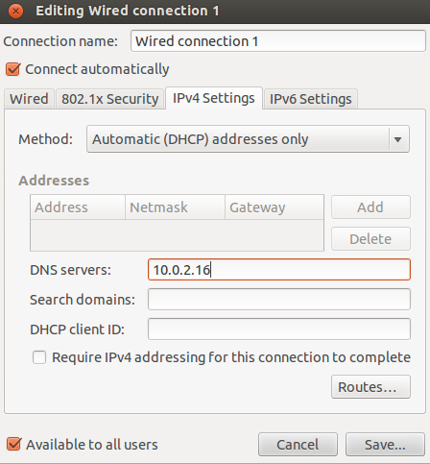
Task: User VM Setup
On the User VM, we need to assign our own VM as the local DNS server:
1.On the dashboard, search System Settings
2.Click "System Settings" -> "Network",
3.Click "Options" in "Wired" Tab,
4.Select "IPv4 Settings" -> "Method" ->"Automatic(DHCP) Addresses Only" and update only "DNS Servers" entry with IP address of BIND DNS Server.
5.Click the "Network Icon" on the top right corner and Select "Wired Connection X". This will refresh the wired network connection and updates the changes.
Run the command on the user VM.
$ dig www.example.com
DNS response contains four field
Question:
Answer:
Authority:
Additional:

Slide 11

Local DNS workflow
Query
Query&update
Local DNS Server
DNS Cache
Answer table
Authority table
User Machine
Answer

Slide 12
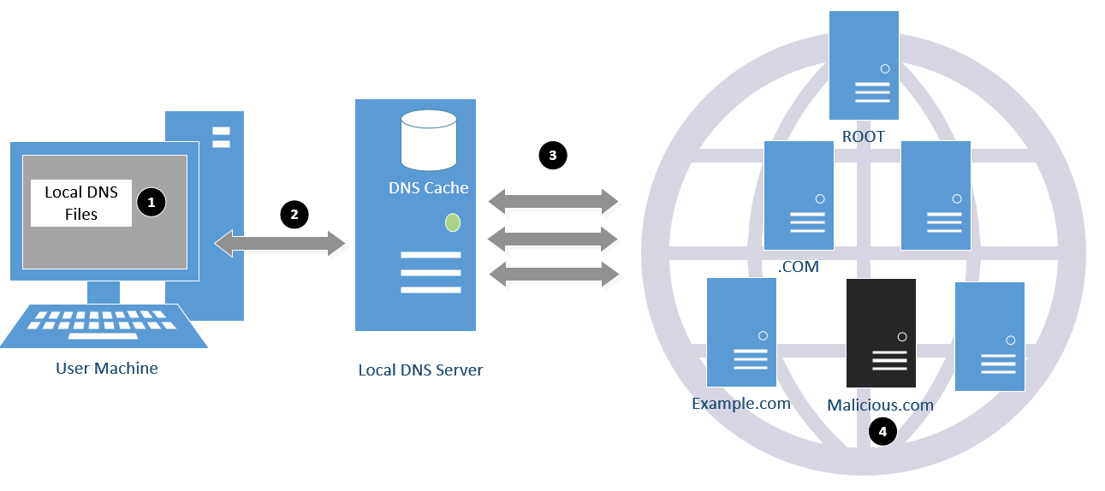
Attack Surfaces in DNS Workflow

Slide 13
Attack Surfaces – Map to the general flow
Local Network
Global DNS
User Computer 10.0.2.7
Local DNS server
(Bind9)
10.0.2.16
DNS Server
DNS Server
app
/etc/hosts
1
Network Settings:
Local DNS server
6
4
query
Bind9 Resolver
DNS Server
DNS Server
Answer
DNS record cache
5
7

Slide 14
Local DNS Cache Poisoning Attack Surface
Local Network
Global DNS
User Computer 10.0.2.7
Local DNS server
(Bind9)
10.0.2.16
DNS Server
DNS Server
app
/etc/hosts
Network Settings:
Local DNS server
6
query
Bind9 Resolver
DNS Server
DNS Server
Answer
DNS record cache

Slide 15


No data related to www.example.net
…
…
Local Network
2
Query for www.example.net
1
Internet
Query:
www.example.net
sniff
attacker
user

Slide 16
No data related to www.example.net
…
…
Local Network
2
Query for www.example.net
Local DNS server
1
Internet
Query:
www.example.net
sniff
3
response:
www.example.net
“1.1.1.1”
attacker
user

Slide 17
No data related to www.example.net
…
…
Local Network
Response www.example.net IP
(ignored)
4
2
Query for www.example.net
Local DNS server
1
Internet
Query:
www.example.net
sniff
3
response:
www.example.net
“1.1.1.1”
attacker
user

Slide 18
No data related to www.example.net
…
…
Local Network
Response www.example.net IP
(ignored)
4
2
Query for www.example.net
Local DNS server
1
5
Internet
Query:
www.example.net
response: www.example.net “1.1.1.1”
sniff
3
response:
www.example.net
“1.1.1.1”
attacker
user

Slide 19
No data related to www.example.net
…
…
Local Network
Response www.example.net IP
(ignored)
4
2
Query for www.example.net
Local DNS server
1
5
Internet
Query:
www.example.net
response: www.example.net “1.1.1.1”
sniff
3
response:
www.example.net
“1.1.1.1”
attacker
user

Slide 20
I know the www.example.net IP in my cache
www.example.net “1.1.1.1”
…
Local Network
Internet
Local DNS server
Query: www.example.net
response: www.example.net “1.1.1.1”
1
2
attacker
user

Slide 21
Response packet structure
Question
www.example.net
www.example.net IP will be attackers’ IP
Answer
Malicious IP
Whatever we fill in
Authority
????
????
Additional
ns.dnslabattacker.net IP

Slide 22
Task: Local DNS cache poisoning
0. (server) Copy the named.conf.options to /etc/bind/ on the local DNS server:
$ sudo cp named.conf.options /etc/bind
$ sudo chown bind /etc/bind/named.conf.options
(server) Create dump.db ﻿in /var/cache/bind/ and change owner & group of dump.db to bind
$ sudo touch /var/cache/bind/dump.db
$ sudo chown bind /var/cache/bind/dump.db
$ sudo chgrp bind /var/cache/bind/dump.db
$ sudo service bind9 restart
(server) Clean the cache every time you start the attack
$ sudo rndc flush
3. (attacker) Run the netwox command (details on the next slide)
4. (client) Run the following command to trigger a DNS request from the local DNS server:
$ dig www.example.net
5. Stop the attack and do the dig again.

Slide 23
Netwox Tool: Command line to attack
Netwox 105: Perform the local DNS cache poisoning attack.
--hostname: The domain you want to attack
--hostnameip: The malicious IP you want to assign to that domain
--authns: The authority of the response (who gives the answer)
--ttl: Time to live
--filter: The pcap expression to focus on certain packet
$ sudo netwox 105 --hostname "www.example.net"-hostnameip “10.20.30.40”
--authns "ns.example.net" --authnsip “10.20.30.50”
--ttl 19000 --filter "src host <localDNS_server IP>" --spoofip "raw"
Once you run the command, the netwox 105 tool will:
Listen to the local network and sniff the DNS request that you are interested.
Build the DNS response according to your configuration and send it back.
Keep doing steps 1 and 2.

Slide 24
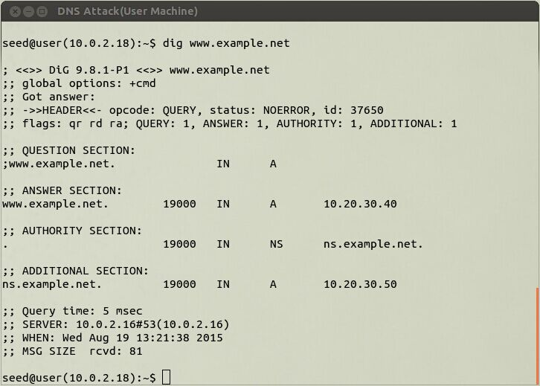
Verify Result on Client

Slide 25
Verify Result on Server
$ sudo rndc dumpdb -cache
$ cat /var/cache/bind/dump.db | grep “www.example.net”

Slide 26
Netwox 105:
Sniff the query and spoof the response to the local DNS server
ROOT name server
Q: www.example.net
Q: www.example.net
.NET name server
Q: www.example.net
Root Response: “10.20.30.40”
Local DNS server
.net Response: “10.20.30.40”
EXAMPLE.NET name server
example.net Response: “10.20.30.40”
attacker

Slide 27
That’s the end of Local DNS attack

